Slide 1

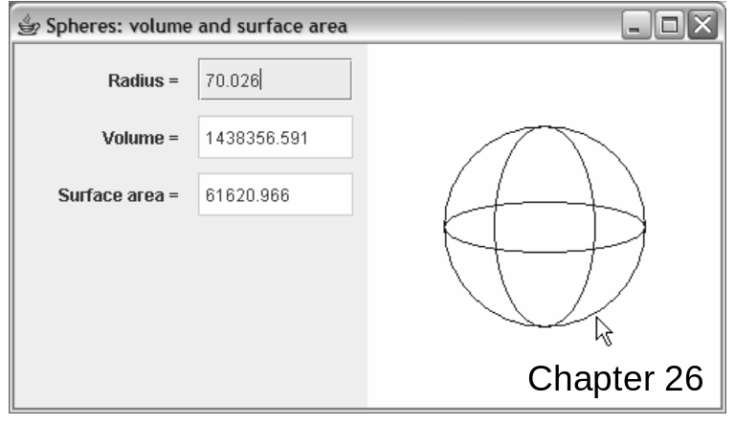
Java Methods
A & AB
Object-Oriented Programming
and Data Structures
Maria Litvin ● Gary Litvin
Design Patterns
Copyright © 2006 by Maria Litvin, Gary Litvin, and Skylight Publishing. All rights reserved.
Notes:
This is a brief introduction to patterns. Hundreds of design patterns have been described in books, at conferences, online, etc.

Slide 2
Objectives:
Explore the concept of design pattern
Get familiar with six introductory design patterns:
  Façade
  Strategy
  Singleton
  Decorator
  Composite
  MVC (Model-View-Controller)
26-<number>
Notes:
Being aware that OO design patterns exist helps you pay more attention to the design stage of your project before rushing to write code.

Slide 3
Design Patterns
Design patterns aim to provide ideas and recipes for sound OO software design.
The origin of the idea can be traced to some influential books on architecture by Christopher Alexander (for example, The Timeless Way of Building, 1979).
Hundreds of OO design patterns have been published since 1995 in books, web sites, etc.
26-<number>
Notes:
The Internet gives ready access to the “pattern” community. Just Google “design patterns.” hillside.net is a good place to start.

Slide 4
Design Patterns (cont’d)
A typical description of a design pattern includes:
  name
  brief statement of purpose
  description
  the types of classes and objects involved
  structural diagram
  example(s)
26-<number>
Notes:
Design patterns are not specific to Java. Code examples may or may not be given.

Slide 5
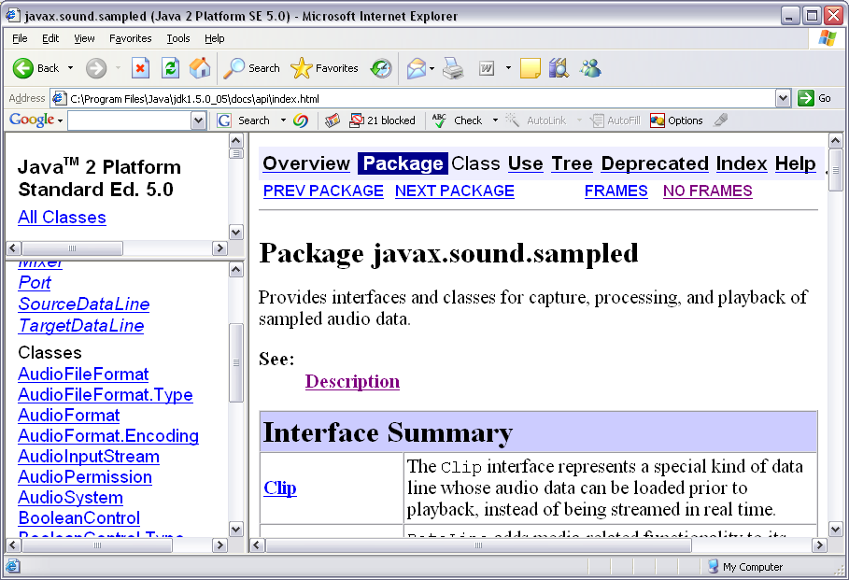
Façade Design Pattern
Serves to facilitate the use of a complicated subsystem or package of classes
Replaces multiple complex interfaces to several classes with one simplified interface to the whole subsystem
EasySound
26-<number>
Notes:
If systems and frameworks were designed with the user in mind, they would include façade classes.

Slide 6
Façade (cont’d)
Can be used to encapsulate a process that involves several steps. For example:
...
Rectangle ocrArea = new Rectangle(200,
20, 120, 30);
ImageEditor imageEditor = new ImageEditor();
image = imageEditor.cut(image, ocrArea);
TextLocator locator = new TextLocator();
ocrArea = locator.findTextField(image);
String charSet = "0123456789";
OCRReader reader = new OCRReader(charSet);
String result = reader.ocr(image, ocrArea);
...
String result = OCR.read(image, ocrArea);
26-<number>
Notes:
Here one statement replaces several calls to library methods. We are only interested in the result.

Slide 7
Strategy Design Pattern
If an object (“Player”) may use different strategies to accomplish a task, make the strategy module pluggable:
  Pass a “Strategy” object to Player’s constructor or method as a parameter.
  The Strategy object “knows” how to accomplish the task in a particular way.
  The Strategy object may also “know” how to adjust the strategy if necessary or pass a strategy object of a different type to Player.
26-<number>
Notes:
Strategy could mean any algorithm, not just in games. For example, a sorting algorithm can be a strategy.

Slide 8
Strategy (cont’d)
public class Player
{
private Strategy myStrategy;
public Player (... , Strategy s)
{
...
myStrategy = s;
}
public void
setStrategy (Strategy s)
{ myStrategy = s; }
public void
performTask (...)
{
myStrategy.doSomething (...);
}
...
}
public interface Strategy
{
void doSomething (...);
}
public class StrategyOne
implements Strategy
{
public void
doSomething(...) {...}
}
public class StrategyTwo
implements Strategy
{
public void doSomething (...)
{ < code > }
}
26-<number>
Notes:
Strategy should be an interface (or an abstract class). Different strategies implement the Strategy interface (or extend the abstract class).

Slide 9
Singleton Design Pattern
Is used when the same object must be accessible in several classes.
A separate class holds a static variable that refers to the singleton.
A static accessor method is provided for the singleton.
The singleton is initialized only on the first call to the accessor.
26-<number>
Notes:
For example, suppose we want to write to the same log file from different places in the program.

Slide 10
Singleton — Example 1
public class SchoolLogo
{
private static ImageIcon logo = null;
public static ImageIcon get ()
{
if (logo == null)
logo = new ImageIcon ("eagles.jpg");
return logo;
}
public class School
{
public static void
main (String [ ] args)
{
ImageIcon logo =
SchoolLogo.get ();
}
}
26-<number>
Notes:
In this example, SchoolLogo is a singleton: we might need to display the same logo in constructors/methods of different classes.

Slide 11
Singleton — Example 2
public class RandNumGenerator
{
private static Random theRandNumGenerator =
new Random();
public static Random getInstance ()
{
return theRandNumGenerator;
}
}
public class Fish
{
...
Random gen = RandNumGenerator.getInstance ();
...
}
26-<number>
Notes:
This example is from the College Board’s Marine Biology Simulation case study (2004-2007).

Slide 12
Decorator Design Pattern
Solves two problems:
  Helps add the same functionality to classes on diverging inheritance paths
Letter
Certified
Registered
LtrWithRetReceipt
LtrWithRetReceipt
  Helps add or modify functionality of an object at run time
Circle cir =
new Circle (x0, y0, radius);
cir.draw ();
cir.move (x, y);
DottedLineCircle cirDL =
new DottedLineCircle (cir);
cirDL.draw ();
26-<number>
Notes:
Decorator implementation can be bug-prone — one must be very careful.

Slide 13
Decorator (cont’d)
The Decorator class (a.k.a. wrapper class) extends the decorated class.
A Decorator (wrapper) object also embeds the decorated (wrapped) object.
Letter
LtrWithRetReceipt
26-<number>
Notes:
Thus LtrWithRetReceipt both IS-A Letter and HAS-A Letter.

Slide 14
Decorator (cont’d)
Decorator class’s constructor takes a wrapped object as a parameter:
public class LtrWithRetReceipt extends Letter
{
private Letter myLetter;
public LtrWithRetReceipt (Letter ltr)
{
myLetter = ltr;
}
...
}
26-<number>
Notes:
The constructor can take other parameters, as well.

Slide 15
Decorator (cont’d)
The decorator object passes method calls to the “decoratee”; can modify some of the methods:
public class LtrWithRetReceipt extends Letter
{
private Letter myLetter;
private static final double retReceiptFee = 1.75;
...
public double getWeight () { return myLetter.getWeight () ; }
public double getCost ()
{ return myLetter.getCost () + retReceiptFee; }
...
}
26-<number>
Notes:
LtrWithRetReceipt inherits fields from Letter, but they are not used and remain uninitialized. You have to be careful when you pass a LtrWithRetReceipt type of object to a method that expects a Letter type of parameter: make sure the method accesses parameter’s fields only through accessors, not directly.

Slide 16
Decorator (cont’d)
Decorator design is a kind of do-it-yourself run-time inheritance.
public class PostageCalculator
{
public static void main (String [ ] args)
{
...
Letter ltr1 = new Letter (weight, destZip);
Letter ltr2 = new LtrWithRetReceipt (ltr1);
System.out.println ( " Cost: " + ltr1.getCost () +
" With return receipt: " + ltr2.getCost ());
}
}
26-<number>
Notes:
Could there be a programming language that has only this kind of dynamic inheritance? Yes.

Slide 17
Decorator (cont’d)
The java.io package relies extensively on the Decorator design pattern:
...
myInputFile =
new BufferedReader (new FileReader (fileName), bufferSize);
26-<number>
Notes:
Some people find multiple layers of wrappers very elegant; others find it confusing.

Slide 18
Composite Design Pattern
Is used to represent recursive (nested) structures
Applies when a list or a set of objects of a certain type is also an object of that type
  Example 1: Text is a composite for Message objects; a Text object is also a Message.
  Example 2: A LinkedList<Object> is a composite for Objects because a LinkedList is an Object.
26-<number>
Notes:
Create an ArrayList<Object> and add another list to it as an object. Print and see what happens: nested lists in the printout.

Slide 19
Composite (cont’d)
Message
The composite class extends the “simple” class.
A Composite object also embeds a list or a set of “simple” or composite objects.
Text
public class Text extends Message
{
private List<Message> messages;
// Holds Message or Text objects
public void add (Message m)
{ messages.add(m); }
...
public void toString ()
{ return messages.toString (); }
}
Relies on polymorphism
26-<number>
Notes:
Because Text IS-A Message, the list messages can hold both simple Message objects as well as Text objects. The toString method is applied polymorphically and returns a list of interspersed messages and lists of messages that can be nested to any depth.

Slide 20
Composite (cont’d)
Another version: both “simple” and “composite” classes implement the same interface
«Interface» Drawable
SimpleStroke
Drawing
26-<number>
Notes:
Here we use a common interface or abstract class as a common secondary data type for a simple object and a composite object.

Slide 21
Composite (cont’d)
public interface Drawable
{
void draw (Graphics g);
}
public class SimpleStroke
implements Drawable
{
...
public void draw (Graphics g)
{
g.drawLine (x1, y1, x2, y2);
}
}
public class Drawing
implements Drawable
{
private Drawable [ ] pics;
...
public void draw (Graphics g)
{
for (Drawable pic : pics)
pic.draw (g);
}
}
pic can be a SimpleStroke or a Drawing
26-<number>
Notes:
Again, the draw method in Drawing can displays simple strokes and drawings nested to any depth. Recursion is hidden.

Slide 22
Model-View-Controller (MVC) Design Pattern
Is used to support different concurrent or optional views of a changing “model.”
The model is an object that represents a system, a situation, a mathematical object.
The views are automatically updated when the model changes.
It is easy to attach different views to the same model.
26-<number>
Notes:
MVC is a very important design pattern. Among other things, it helps to separate display and GUI from the processing part.

Slide 23
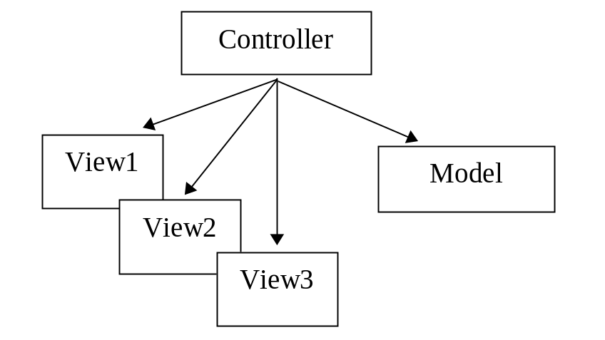
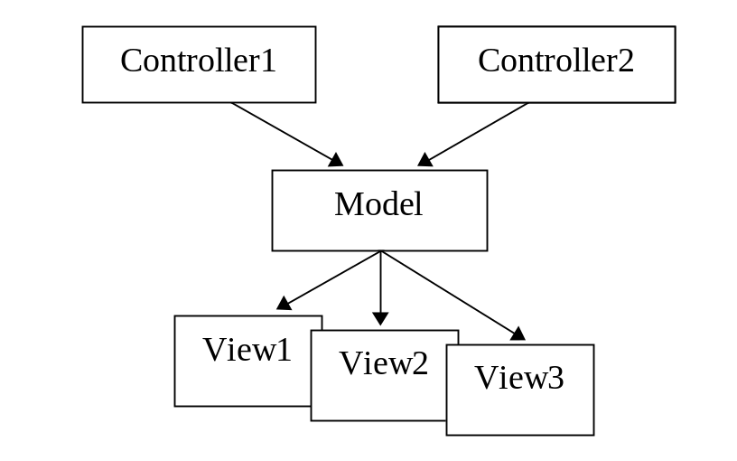
MVC (cont’d)
“Totalitarian” design
MVC design
When the model’s state changes, the model updates all the views attached to it
26-<number>
Notes:
MVC designs are more flexible because it is easy to add a new view by adding just one line of code.

Slide 24
MVC (cont’d)
The model class extends java.util.Observable, which provides addObserver, setChanged, and notifyObservers methods:
public class Sphere extends java.util.Observable
{
...
public void setRadius (double r)
{
myRadius = r;
setChanged ();
notifyObservers ();
}
...
}
26-<number>
Notes:
Note that despite its interface-like name java.util.Observable is a class.

Slide 25
MVC (cont’d)
A view class implements java.util.Observer by providing an update method:
public class TextView implements java.util.Observer
{
...
public void update (Observable model, Object arg)
{
Sphere s = (Sphere) model;
...
...
public class GraphicsView implements java.util.Observer
{
...
public void update (Observable model, Object arg)
{
Sphere s = (Sphere) model;
double r = s.getRadius ();
...
}
}
26-<number>
Notes:
On the other hand, java.util.Observer is an interface.

Slide 26
MVC (cont’d)
main (or another constructor or method) can attach one or more views to the model:
public class MVCSphereDemo
{
public static void main (String [ ] args)
{
Sphere sphere = new Sphere (100);
sphere.addObserver (new TextView ());
sphere.addObserver (new GraphicsView ());
...
}
...
}
26-<number>
Notes:
Both TextView and GraphicsView implement java.util.Observer.

Slide 27
Review:
What is the purpose of design patterns?
Describe briefly the Façade design pattern.
When do we use Singleton?
Come up with an example where the Strategy design pattern is called for.
Name a library package where Strategy is used.
26-<number>
Notes:
What is the purpose of design patterns?
To provide guidelines for sound designs and avoid common design mistakes.
Describe briefly the Façade design pattern.
It provides a simplified interface to a system of classes.
When do we use Singleton?
When we need to access exactly the same object from different classes in the program.
Come up with an example where the Strategy design pattern is called for.
In the Chomp program (Chapter 12), different strategies may be used for different board sizes and levels of play.
Name a library package where Strategy is used.
In Swing, component layout is a strategy attached to a component.

Slide 28
Review (cont’d):
Describe briefly the Decorator design pattern.
Name a library package where Decorator is used.
What is the purpose of the Composite design pattern?
Come up with an example where the Composite design pattern should be used.
26-<number>
Notes:
Describe briefly the Decorator design pattern.
A decorator class extends the decorated class. At the same time, a decorator object has a decorated object as an instance variable. The decorator constructor takes a “decoratee” as a parameter. The decorator channels method calls to the “decoratee” but can add or modify some of the methods.
Name a library package where Decorator is used.
java.io.
What is the purpose of the Composite design pattern?
To represent a structure with nested substructures conveniently.
Come up with an example where the Composite design pattern should be used.
A menu in which a menu item can be a submenu.

Slide 29
Review (cont’d):
What is the main idea of the Model-View-Controller design pattern?
Name the Java library tools (classes, interfaces, methods) that support MVC.
26-<number>
Notes:
What is the main idea of the Model-View-Controller design pattern?
One or more “views” (observers) are attached to the model; the model notifies the views when it changes and calls their update methods.
Name the Java library tools (classes, interfaces, methods) that support MVC.
java.util.Observable class and java.util.Observer interface.

